Slide 1
Educational Studies in Mathematics and the Future of Mathematics Education Research
Arthur Bakker
Utrecht University
February 12, 2021, 11:00 – 12:45 (ET)
MSU Mathematics Education
Virtual Colloquium

Slide 2
Plan
Educational Studies in Mathematics
International survey (conducted with Jinfa Cai, previous editor of JRME)
Q&A after 12:00

Slide 3
Rankings
JRME and ESM considered the two A* journals in
Törner, G., & Arzarello, F. (2013). Grading mathematics education research journals. Mitteilungen der Gesellschaft für Didaktik der Mathematik, 39(95).
See also
Nivens, R. A., & Otten, S. (2017). Assessing journal quality in mathematics education. Journal for Research in Mathematics Education, 48(4), 348–368.
Williams, S. R., & Leatham, K. R. (2017). Journal quality in mathematics education. Journal for Research in Mathematics Education, 48(4), 369–396.

Slide 4
Commonalities
In search of quality, real contribution
Working together where appropriate
Actively promoting math ed research: editorials, workshops, working jointly on anti-racist review guidelines with other journals…
Bakker, A., Cai, J., English, L., Kaiser, G., Mesa, V., & Van Dooren, W. (2019). Beyond small, medium, or large: Points of consideration when interpreting effect sizes. Educational Studies in Mathematics, 102(1).
Cai, J., Morris, A., Hohensee, C., Hwang, S., Robison, V., Cirillo, M., ... & Bakker, A. (2020). Maximizing the quality of learning opportunities for every student. Journal for Research in Mathematics Education, 51(1).
Cai, J., Morris, A., Hohensee, C., Hwang, S., Robison, V., Cirillo, M., ... & Bakker, A. (2020). Addressing the problem of always starting over: Identifying, valuing, and sharing professional knowledge for teaching. Journal for Research in Mathematics Education, 51(2).

Slide 5
Some features
Two EiC plus eight associate editors (Africa, North America, Europe); editorial board members across all continents
IF: 1.500
Published 78 papers in 2020
81+ manuscripts per year (now no space restriction)
Open access option

Slide 6
Some ESM Statistics
 | 2016 | 2017 | 2018 | 2019 | 2020
# Submitted | 281 | 322 | 301 | 426 | 560
# Accepted | 60 | 51 | 69 | 49 | 88
# Downloads | 163,111 | 179,618 | 210,962 | 258,393 | 318,150
2-year impact factor | 0.959 | 1.100 | 1.292 | 1.500

Slide 7
ESM scope
E: educational → not purely psychology or in the context of mathematics education
S: studies → proper research (not just evaluation of a course, design of materials, educational idea)
M: mathematics → specific to math
Scope issues: domain-specific pedagogical/didactical,socio-political; check references (enough in MER journals?)
Methods: all research approaches welcome

Slide 8
Q&A on ESM?

Slide 9
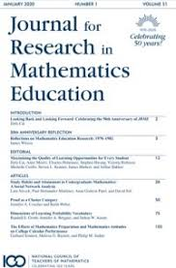
Part 2: Survey as far as time permits
Educational Studies in Mathematics (*1968)
and
Journal for Research in Mathematics Education (*1970)
Because of their 50th anniversaries

Slide 10
Survey question 2019
On what themes should research in mathematics education focus
in the coming decade?
Spread widely to email lists
Aimed for listening to voices across the globe

Slide 11
Responses
 | # countries | # responses
Europe | 14 | 70.5
Asia | 12 | 81
North America | 3 | 29.5
Africa | 9 | 27
South America | 2 | 10
Oceania | 2 | 11
 | 43 | 229

Slide 12
But then…

Slide 13
Survey question 2020
Follow-up question (November 26):
Has the pandemic changed your view on the themes of mathematics education research for the coming decade? If so, how?

Slide 14
Analysis part 2
N = 108 responses
Ranging from “No” to responses with 2215 words (and relevant publications): median 86.5 words; mean 148 number of words

Slide 15
Themes 2019 (drawing removed for copyright reasons; to appear in ESM, hopefully 107(1)
Category | % of responses
1 Goals of mathematics education | 54
2 Approaches to teaching | 64
3 Relation of mathematics education with other practices | 36
4 Professional development of teachers | 23
5 Technology | 22
6 Equity, diversity, inclusion | 20
7 Affect (engagement, identity, interest, motivation…) | 17
8 Assessment | 9

Slide 16
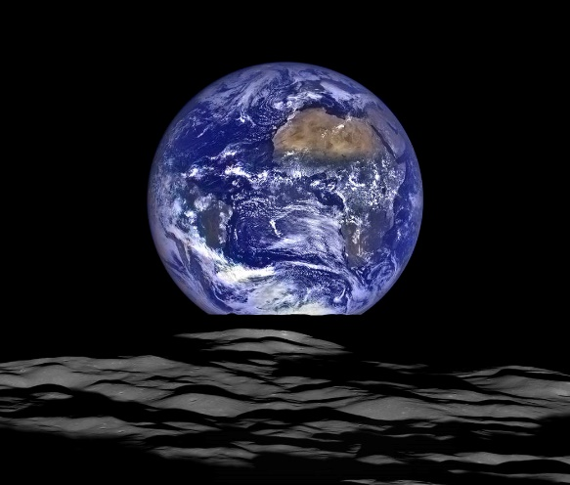
Theme 1: Goals
Societal goals
Avoiding extinction as a human species and toxic nationalism, resolving climate change, building a sustainable future
Educational goals
Emphasis on: statistical literacy, computational and algorithmic thinking, artificial intelligence, and data science.
Math Ed should help learners deal with evidence, reasoning, argumentation, and proof
© NASA/Goddard/Arizona State University
Notes:
First, important, but not part of MER? Yet good if MER could frame its content in the bigger picture, which may motivate students

Slide 17
Goals 2020
Goals reinforced:
How can mathematics education contribute to saving our planet and more social justice?
Statistical literacy, public communication, modeling, exponential growth, critical thinking, …

Slide 18
Theme 2: Approaches
Curriculum, infrastructure
How to achieve aforementioned goals?
Coherent, balanced curriculum: how?
How to monitor curriculum reform?
Continuity between school systems
Teaching approaches
collaborative learning, dialogic teaching, critical thinking, modeling, personalized, problem-based learning, embodied design, visualization, interleaved learning, challenge-based education: cross-curricular topics addressing the bigger issues in the world
Notes:
Rohrer, D., Dedrick, R. F., & Stershic, S. (2015). Interleaved practice improves mathematics learning. Journal of Educational Psychology, 107(3), 900–908. https://doi.org/10.1037/edu0000001

Slide 19
Approaches 2020
More emphasis on teaching approaches using modeling, critical thinking, mathematical literacy, eyes on the ‘real world’
How to promote interaction, collaboration, higher order thinking online?

Slide 20
Theme 3: Mathematics education in relation to other practices
Math Education is widely considered too isolated from
Students’ life worlds (e.g., home, leisure)
Further education (service math, e.g., engineering)
Workplace
Citizenship
Policy, economy, finance

Slide 21
Relations to other practices 2020
‘Outside’ world even more important
How do students learn at home? How do parents/guardians help? How can teachers stay in touch across virtual boundaries?
Higher need for monitoring, self-regulation

Slide 22
Theme 4: Teacher professional development
Theme touches all other aspects for pre-service and in-service teachers
Which approaches help to achieve goals?
Connect to other practices?
How to use technology?
How to assess, engage students?

Slide 23
Professional Development 2020
Importance of teachers in dealing with the new situation
Expertise required to
Use (new) technology
Use new assessment techniques
Find new distribution of labor with children’s parents/guardians
How to proceed after the lockdown?

Slide 24
Theme 5: Technology
Goals: preparation for a technological world (learning to use/understand technology)
Approaches: technology as a tool to learn
Technology to link with other practices
Teachers: how to use technology
Assessment

Slide 25
Technology 2020
Much more interest in using technology – low key (WhatsApp) and more advanced tools
More on assessment online
How to use technology in a “scattered” world, where space-time works so differently? How to teach with hardly any internet access?
How to stimulate social, embodied, gestural interaction?

Slide 26
Theme 6: Equity, diversity, inclusion
Equality, access for all, social justice, democracy, antiracism, care for children with challenging backgrounds…

Slide 27
Equity 2020
Importance reinforced, reiterated, even more relevant
Digital divide
Widening achievement gap
Research needed on how to remedy the consequences of the pandemic
How to provide access to high quality math ed for all?

Slide 28
Theme 7: Affect
“Do not separate from cognition”
Motivation, interest, attitudes, love, curiosity
Engagement, fun, entertainment, enjoyment
Self-efficacy, self-esteem, self-competence
Identity (student and teacher)
In practice one often sees:
Anxiety, alienation

Slide 29
Affect 2020
Challenge of motivating students online, staying in touch with them, joint attention, avoid alienation
Stronger focus on student well-being

Slide 30
8. Assessment
Achieving goals
Success of teaching approaches
With technology (e-assessment)
By teachers (formative, summative…)

Slide 31
Assessment 2020
Online assessment
How to assess that we value?

Slide 32
Follow-up 2020 overarching comments
Respondents saw their themes reinforced, reiterated, even more relevant, important, or urgent:
“the pandemic sharpens essential questions on mathematics teaching”
“it amplified malfunctions”
Pandemic is like a magnifying glass on the bigger issues:
Inequity is exacerbated; discrepancies due to the digital divide are even worse

Slide 33
Q&A
After Pat Herbst’s JRME presentation
Unless there is time now

